Slide 1
11/17/2021
1
MODULE 6
GRAPH THEORY
SY Comp Odd 2021-22

Slide 2
Varying Applications (examples)
11/17/2021
2
Computer networks
Distinguish between two chemical compounds with the same molecular formula but different structures
Solve shortest path problems between cities
Scheduling exams and assign channels to television stations

Slide 3
Topics Covered
11/17/2021
3
Graphs and Subgraphs 05
CO4
6.1
Definitions, Paths and circuits, Types of Graphs,
Eulerian and Hamiltonian Planer graphs Isomorphism of graphs Subgraph
6.2
6.3
6.4

Slide 4
Definitions - Graph
11/17/2021
4
A graph G consists of a finite set v of objects called vertices, a finite set E of objects called edges and a function γ that assigns to each edge a subset {v, w} where v and w are vertices (and may be the same).
We will write G = (V, E, γ)

Slide 5
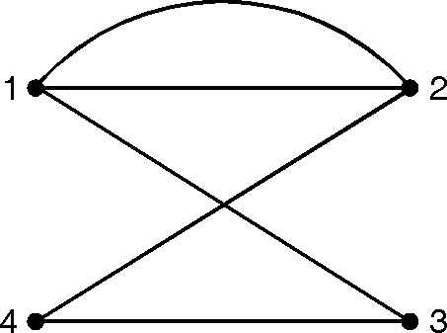
Graph
11/17/2021
5
Let V={1, 2, 3, 4}
and E={ e₁, e₂, e₃, e₄, e₅}. Let g be defined by
γ(e₁)= γ (e₅) = {1, 2},
γ (e₂)= {4, 3}, γ(e₃)= {1, 3}, γ(e₄)={2, 4}.
Then G={V, E, γ) is a graph as shown in

Slide 6
Definitions – Edge Type
11/17/2021
6
Directed: Ordered pair of vertices. Represented as (u, v)
directed from vertex u to v.
u v
Undirected: Unordered pair of vertices. Represented as {u, v}. Disregards any sense of direction and treats both end vertices interchangeably.
u
v

Slide 7
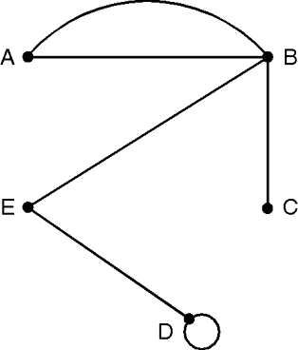
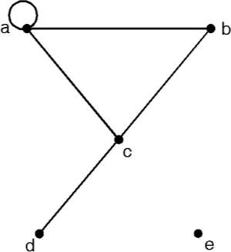
Definitions
11/17/2021
7
Degree :
The degree of a vertex is the number of edges having that vertex as an end point.
Loop :
A graph may contain an edge from a vertex to itself, such an edge is referred to as a loop. A loop contributes 2 to the degree of a vertex. Since that vertex serves as both end points of the loop.
Isolated Vertex :
A vertex with degree 0 will be called an isolated vertex.
Adjacent Vertices :
A pair of vertices that determine an edge are
adjacent vertices.

Slide 8
Simple undirected graph
11/17/2021
8
Simple (Undirected) Graph: consists of V, a nonempty set of vertices, and E, a set of unordered pairs of distinct elements of V called edges (undirected)
Representation Example: G(V, E), V = {u, v, w}, E = {{u, v},
{v, w}, {u, w}}
u
v
w

Slide 9
Directed graph
11/17/2021
9
Directed Graph: G(V, E), set of vertices V, and set of Edges
E, that are ordered pair of elements of V (directed edges)
Representation Example: G(V, E), V = {u, v, w}, E = {(u, v), (v, w), (w, u)}
u
v
w

Slide 10
Terminology – Directed graphs
11/17/2021
10
In-degree (u): number of in coming edges
Out-degree (u): number of outgoing edges
Representation Example: For V = {u, v, w} , E = { (u, w), ( v, w), (u, v) },
indeg(u) = 0, outdeg (u) = 2, indeg(v) = 1,outdeg(v)=1 indeg(w) = 2, outdeg (w) = 0
u
v
w

Slide 11
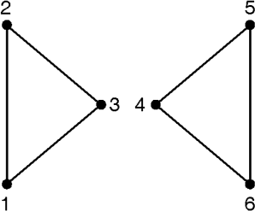
Connected graph
11/17/2021
11
A graph is called connected if there is a path from any
vertex to any other vertex in the graph.
Otherwise, the graph is disconnected. If the graph is disconnected, the various connected pieces are called the components of the graph.

Slide 12
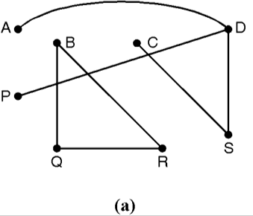
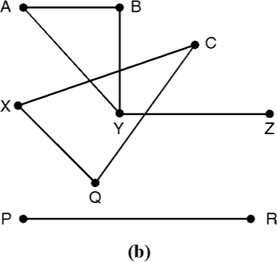
Problem
11/17/2021
12
Determine whether the graph (shown in Fig. 6.5) is connected or disconnected. If disconnected find its connected component.
Graph shown in Fig. 6.5 (a) is not connected its connected components are {A, D, P, S, C} and {B, Q, R}
Graph shown in Fig. 6.5 (b) is not connected its connected components are {A, B, Y, Z}, {C, X, Q}, {P, R}

Slide 13
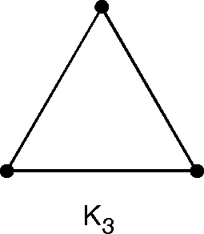
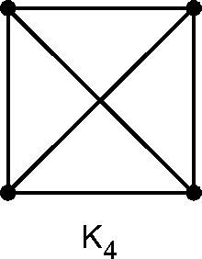
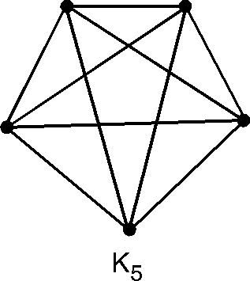
Complete Graph
11/17/2021
13
For each integer n ≥1, let K_{n} denote the graph with vertices
{v₁, v₂, … v_{n} } and with an edge {v_{i}, v_{j}} for every i and j.
In other words, every vertex in K_{n} is connected to every other vertex. In

Slide 14




More Graphs
11/17/2021
14
Linear graph:
Discrete Graph:

Slide 15
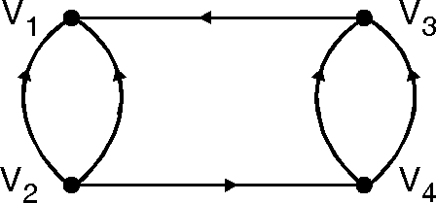
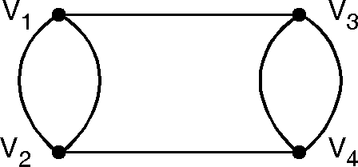
Multigraph
11/17/2021
15
Directed graph having multiple edges between two vertices is called as multigraph. Undirected graph having more than one edge between two vertices is also called as Multigraph.

Slide 16
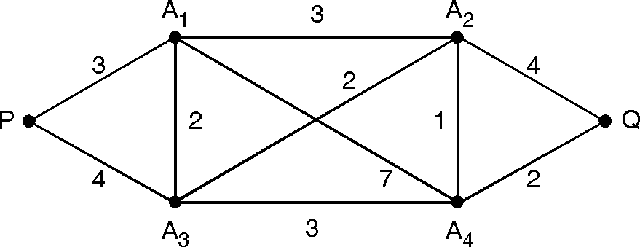
Labelled and weighted graph
11/17/2021
16
A graph G is called a labelled graph it its edges and /or vertices are assigned data of one kind or another. In particular, G is called a weighted graph if each edge 'e' of G is assigned a non–negative number called the weight or length of V.

Slide 17
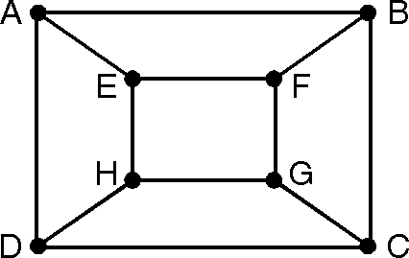
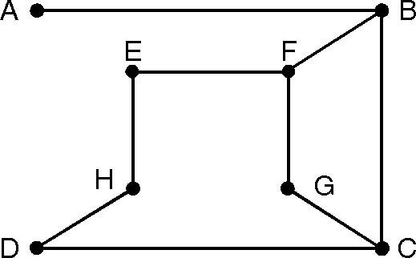
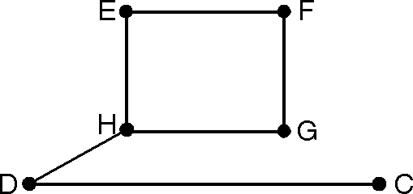
Subgraph
11/17/2021
17
(a)
Let G = (V, E, γ) is a graph. Choose a subset E₁ of the
edges in E and a subset V of the vertices in V. So that V
1 1
(b)
contains all the end points of edges in E₁. Then H = (V₁, E₁,
γ₁) is also a graph, where γ₁ is γrestricted to edges in E1. Such a graph H is called a subgraph of G.

Slide 18
Spanning Subgraph
11/17/2021
18
A subgraph is said to be spanning subgraph if it contains
all the vertices of G.

Slide 19
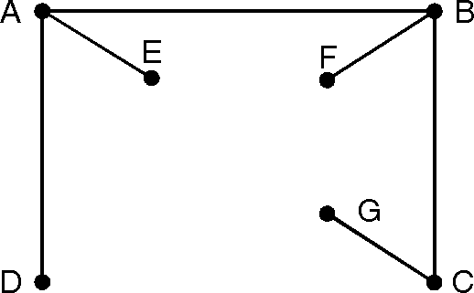
Complement of Subgraph
11/17/2021
19
The complement of a subgraph G' = (V', E') with respect to
the graph G = (V, E) is another subgraph
G" = (V", E") such that E" is equal to E – E' and V" contains only the vertices with which the edges in E" are incident.

Slide 20
Complement of Subgraph
11/17/2021
20
u
u
u
v _{w}
G
v
w
v
H₁
H₂

Slide 21
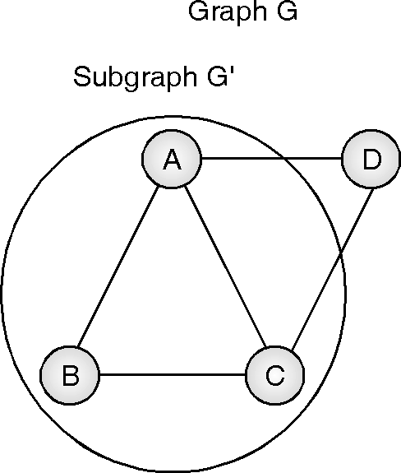
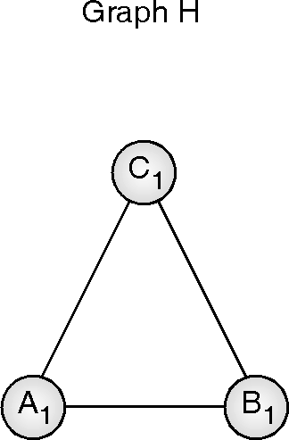
Subgraph Isomorphism
11/17/2021
21
The subgraph isomorphism is a computational task in which two graphs G and H are given as input, and one must determine whether G contains a subgraph that is isomorphic to H.
f : {(A, C₁), (B, A₁), (C, B₁)}

Slide 22
Handshaking Lemma
11/17/2021
22
Consider a graph G with e number of edges and n number of vertices. Since each edge contributes two degrees, the sum of the degrees of all vertices in G is twice the number of edges in G i.e.
∑ d( vi) = 2 e

Slide 23
Problem
11/17/2021
23
How many nodes are necessary to construct a graph with
exactly 6 edges in which each node is of degree 2.
Soln. : Suppose there are n vertices in the graph with 6 edges. Also, given the degree of each vertex is 2.
Therefore by handshaking lemma,
Σd (v_{i})=2e = 2 × 6
⇒ d (v₁) + d (v₂) + … + d (v_{n}) = 12.
⇒ |  | = | 12
⇒ | 2n | = | 12
⇒ | n | = | 6
Hence, 6 nodes are required to construct a graph with 6 edges in which each node is of degree 2.

Slide 24
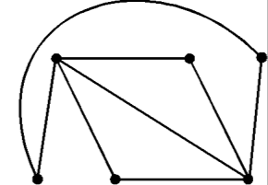
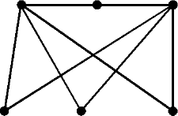
Problem
11/17/2021
24
Determine the number of edges in a graph with 6 nodes, 2
of degree 4 and 4 of degree 2. Draw two such graphs.
Soln: Suppose the graph with 6 vertices has e number of edges. Therefore, by handshaking lemma.
Σd (v_{i}) = 2e
⇒ d (v₁) + d (v₂) + d (v₃) + d (v₄) + d (v₅) + d (v₆ ) = 2e Now, given 2 vertices are of degree 4 and 4 vertices are of degree 2.
Hence from the above equation
⇒ (4 + 4) + (2 + 2 + 2 + 2) = 2e
⇒ | 16 | = | 2e
⇒ | e | = | 8

Slide 25
Path & Circuit
11/17/2021
25
Path : A path is a sequence of vertices where no edge is
chosen more than once
A path is called simple if no vertex repeats more than once
Length of Path : Number of edges in a path is called as
length of path
Circuit: A circuit is a path that begins and ends with the same vertex

Slide 26
Euler path and Euler circuit
11/17/2021
26
EULER PATH
A path in a graph G is called an Euler path if it includes every edge exactly once
EULER CIRCUIT
A Euler path that is a circuit

Slide 27
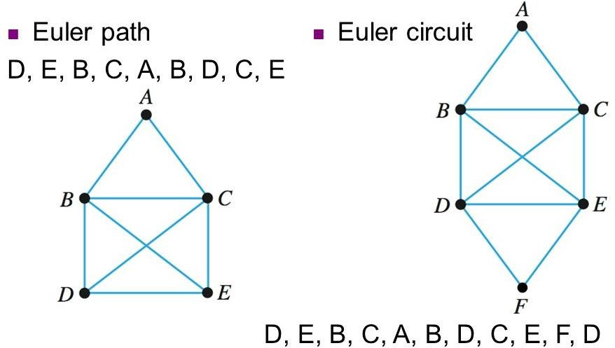
Example
11/17/2021
27

Slide 28
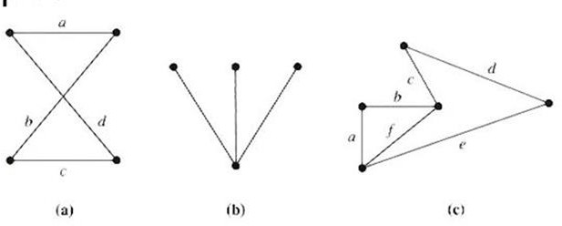
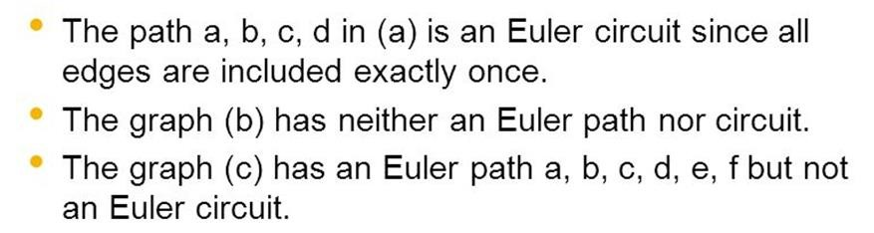
Identify Euler path and circuit
11/17/2021
28

Slide 29
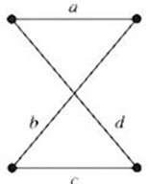
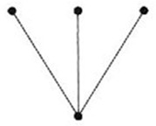
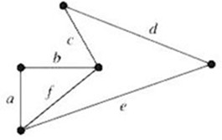
Theorem: EULER CIRCUIT
11/17/2021
29
If graph G has a vertex of odd degree , then there can be no Euler circuit in G
If G is a connected graph and every vertex has an even degree then there is a Euler circuit in G
Theorem: EULER PATH
If a graph G has more than two vertices of odd degree then there can be no Euler path in G
If G is connected and has exactly two vertices of odd degree then there is a Euler path in G
All vertices have even degree
All vertices have odd degree
Two vertices have odd degree

Slide 30
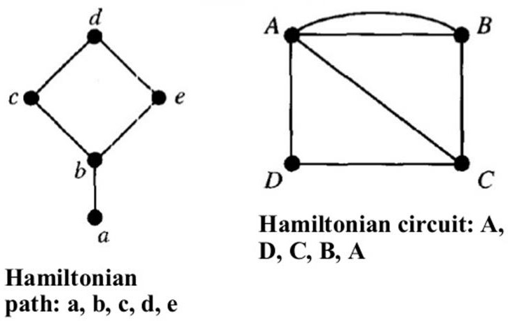
Hamiltonian Path & Circuit
11/17/2021
30
A Hamiltonian path contains each vertex exactly once
A Hamiltonian circuit is a circuit that contains each vertex exactly once except for the first vertex which is also the last

Slide 31
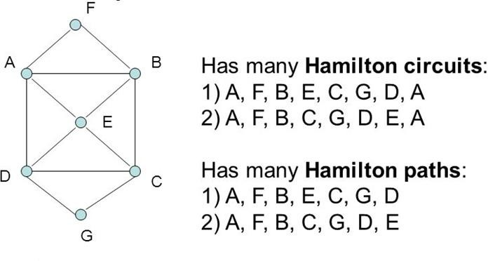
Example
11/17/2021
31

Slide 32
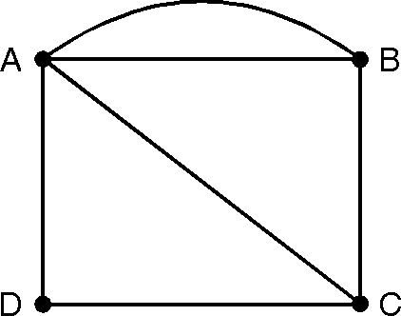
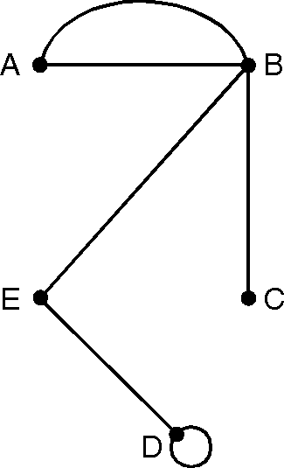
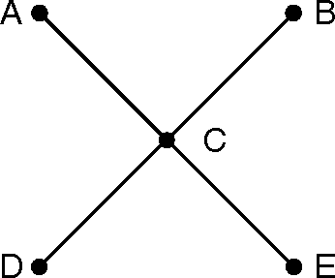
Examples
11/17/2021
32
Hamiltonian Circuit:ADCBA
Hamiltonian Path:DEBAC

Slide 33
11/17/2021
33
Theorem: HAMILTONIAN CIRCUIT
G has a Hamiltonian circuit if for any two vertices u and v of G that are not adjacent ,degree(u)+degree(v) ≥ nos of vertices
G has a Hamiltonian circuit if each vertex has degree greater than or equal to n/2

Slide 34
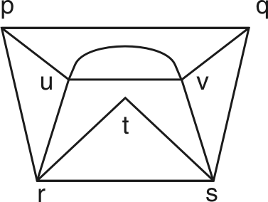
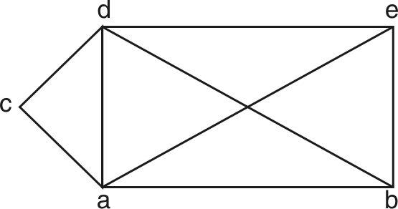
Problem
11/17/2021
34
Determine the Eulerian and Hamiltonian path, if exists, in
the following graphs.
Hamiltonian path : p, u, v, q, s, t, r Hamiltonian circuit : r, p, u, v, q, s, t, r
Eulerian path : (p, u, v, q, s, v, u, r, t, s, r, p, q)
Hamiltonian path : c, d, e, b, a Hamiltonian circuit : c, d, b, a, c Eulerian path : (e, d, b, a, d, c, a, e, b)

Slide 35
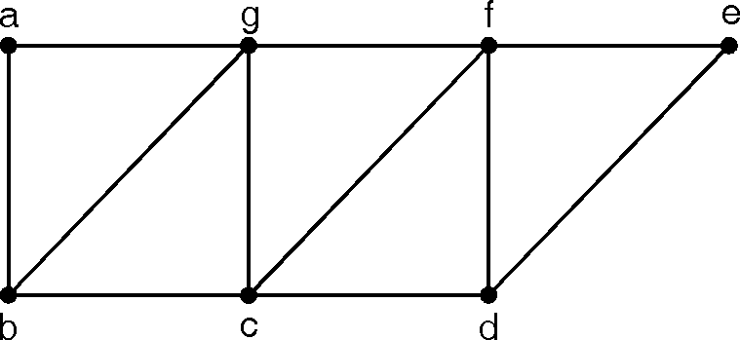
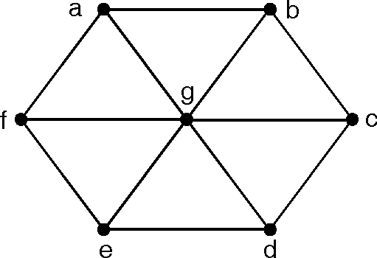
Identify Euler path, circuit, Hamiltonian path and circuit
11/17/2021
35
(a) two vertices b and d have odd degree. Hence there is an Euler path.
π: b, a, g, f, e, d, c, b, g, c, f, d
(a)
(b)6 vertices have odd degree, 3 and 1 vertex of even degree, 6.
So Euler path does not exist in this graph.
(b)

Slide 36
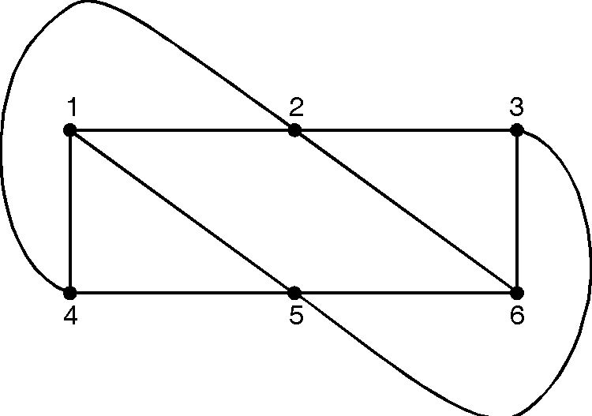
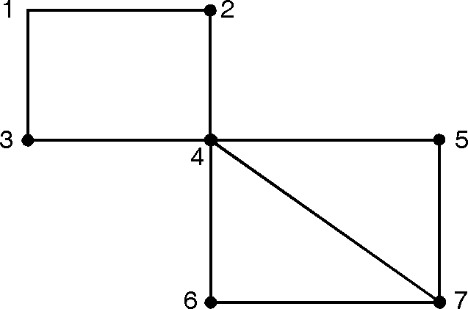
Identify Euler path, circuit, Hamiltonian path and circuit
11/17/2021
36
Number of vertices is 6. Each vertex has degree greater than equal to 6/2. So there is an Hamiltonian circuit.
π : 1, 4, 5, 6, 3, 2, 1
There is no Hamiltonian circuit. But there is an Hamiltonian path
π: 3, 1, 2, 4, 6, 7, 5.

Slide 37
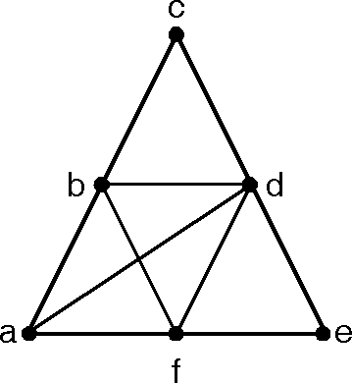
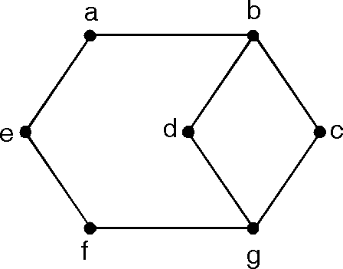
Identify Euler path, circuit, Hamiltonian path and circuit
11/17/2021
37
(i) Eulerian Path : π: a, b, c, d, b, f, d, a, f, e, d G has 2 vertices of odd degree.
Hamiltonian Circuit : a, b, c, d, e, f, a. Hamiltonian Path : a, b, c, d, e, f
(ii) Eulerian Circuit : -
Eulerian Path : g, d, b, a, e, f, g, c, b.
Hamiltonian Path : d, b, a, e, f, g, c

Slide 38
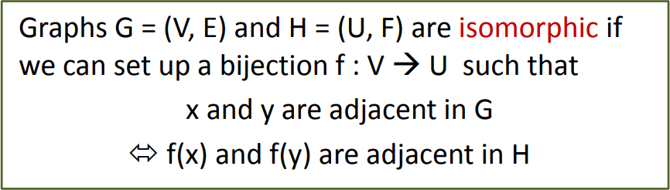
Isomorphic Graph
11/17/2021
38
Function f is called isomorphism
Same no. of vertices
Same no. of edges
Equal no. of vertices with a given degree
Adjacency of vertices

Slide 39
Graph - Isomorphism
11/17/2021
39
Representation example: G1 = (V1, E1) , G2 = (V2, E2)
f(u1) = v1, f(u2) = v4, f(u3) = v3, f(u4) = v2 No. of vertices:4
No. of edges:4
All vertices have degree 2
u₁
u₂
v₁
v₂
u₃
u₄
v₄
v₃

Slide 40


Isomorphism of Graphs
11/17/2021
40
Example I: Are the following two graphs isomorphic?
a a
e
b
e
b
c
c d
d
Solution: No. of vertices: 6, No. of edges: 6
3 vertices with degree 2, 2 vertices with degree 3
Then the isomorphism f from the left to the right graph is:
f(a)=e, f(b)=a, f(c) = b, f(d) = c, f(e) = d.

Slide 41

Isomorphism of Graphs
11/17/2021
41
Example II: How about these two graphs?
a
a
b
e
e
b
c
c
d
d
Solution: No. of vertices: 5, No. of edges:6
No, they are not isomorphic, because they differ in the degrees of their vertices.Vertex d in right graph is of degree one, but there is no such vertex in the left graph.

Slide 42
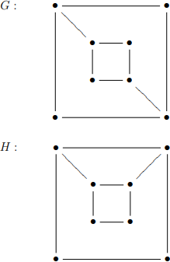
Isomorphism of Graphs
11/17/2021
42
Example III: Are the following two graphs isomorphic?
Solution:
Both graphs contain
8 vertices and 10 edges
Nos of vertices of degree 2 = 4 Nos of vertices of degree 3 = 4 Adjacency : There exists no vertex of degree 3 whose adjacent vertices have same degree in both graphs So its not ISOMORPHIC

Slide 43
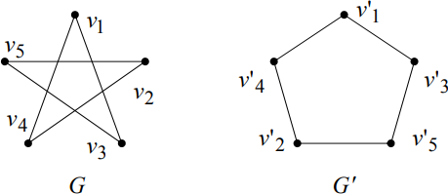
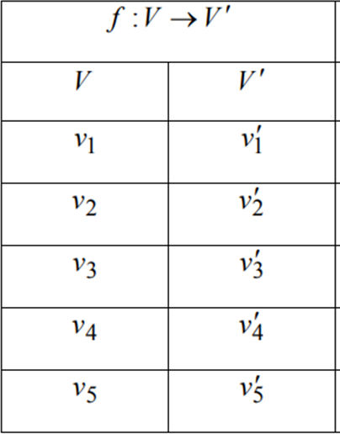
Isomorphism of Graphs
11/17/2021
43
Example IV: Are the following two graphs isomorphic?
Solution: Both graphs have 5 vertices and 5 edges. All vertices
have degree 2.

Slide 44
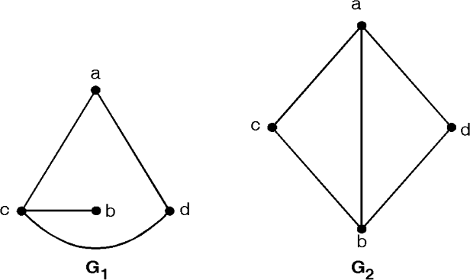
Isomorphism of Graphs
11/17/2021
44
Example V: Are the following two graphs isomorphic?
Solution: Here G1 and G2 both have 4 vertices but G1 has 4 edges
and G2 has 5 edges. Hence G1 is not isomorphic to G2.

Slide 45
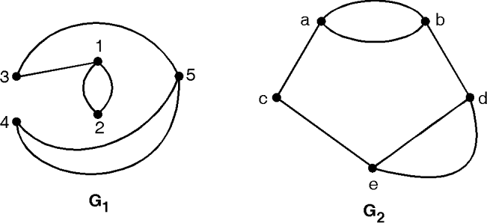
Isomorphism of Graphs
11/17/2021
45
Example VI: Are the following two graphs isomorphic?
Solution: G1 and G2 both have 5 vertices but G1 has 6 edges while
G2 has 7 edges. Hence G1 ≇ G2. That is G1 is not isomorphic to G2.

Slide 46


Planar Graphs
11/17/2021
46
A graph (or multigraph) G is called planar if G can be drawn in the plane with its edges intersecting only at vertices of G, such a drawing of G is called an embedding of G in the plane.
Application Example: VLSI design (overlapping edges requires extra layers), Circuit design (cannot overlap wires on board)
Representation examples: K₁,K₂,K₃,K₄ are planar, Kn for
n>4 are non-planar
K₄

Slide 47
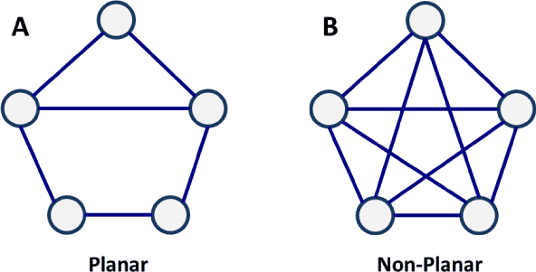
Examples
11/17/2021
47

Slide 48
Planar Graphs Example
11/17/2021
48

Slide 49
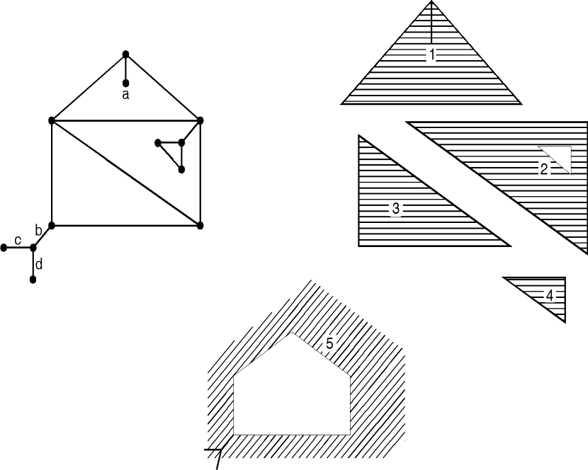
Planer Graph
11/17/2021
49
Theorem : Euler's connected planar graph theorem
v – e + r = 2
number of regions
number
of vertices
number of edges

Slide 50
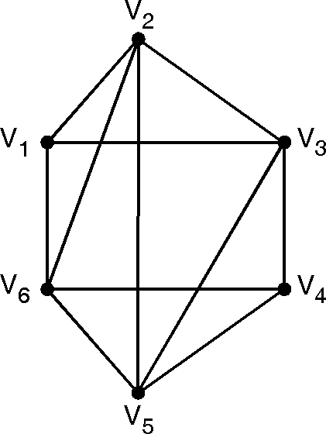
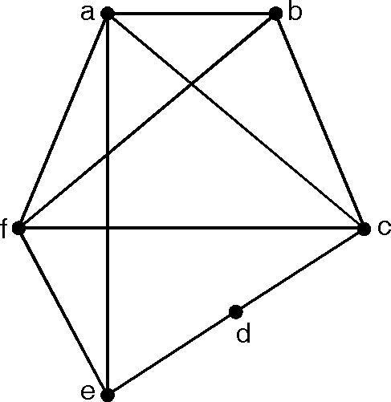
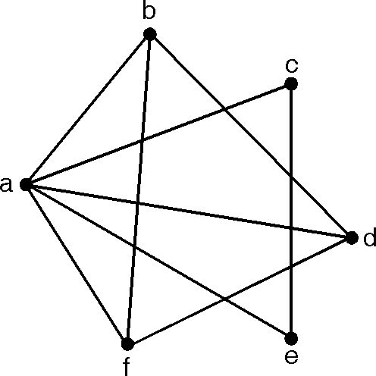



11/17/2021
50
Q. 1) By drawing the graph, show that following graphs are planar graphs

Slide 51

11/17/2021
51
Q. 2 : How many edges must a planar graph have if it has 7 regions and 5 nodes. Draw one such graph.
Soln. :
According to Euler's formula, in a planar graph
v – e + r = 2
where v, e, r are the number of vertices, edges and regions in a planar graph.
Here
v = 5, r =7, e = ?
v – e + r=2 5 – e + 7=2
e=10
Hence the given graph must have 10 edges.

Slide 52


11/17/2021
52
Q. 3 : Determine the number of regions defined by a connected planar graph with 6 vertices and 10 edges. Draw a simple and a multi-graph.
Soln. :
Given v = 6, e = 10
Hence by Euler's formula for a planar graph
v – e + r=2 6 – 10 + r=2
r=6
Hence the graph should have 6 regions.
(a) Simple Graph
(a) Multi-Graph

Slide 53
11/17/2021
53
Q. 4 : A connected planar graph has 9 vertices having degrees 2, 2, 2, 3, 3, 3, 4, 4 and 5. How many edges are there ?
Soln. :
By handshaking lemma
Σd (vi) =2e
d (vi) =
e =
where
degree of ith vertex number of edges
For given graph
2 + 2 + 2 + 3 + 3 + 3 + 4 + 4 + 5 = 2.e
28 =
2e
14
e =
There are 14 edges.
\

Slide 54
11/17/2021
54
Ex. 5 : Suppose that a connected planer graph has 20 vertices, each of degree 3 into how many regions does a representation of this plan graph split the plane ?
Soln. :
| V |=20 = number of vertices
degree of each vertex = 3
By hand shaking Lemma
 | Σ d(Vi) | = | 2 e
 | 20 × 3 | = | 2 e
⇒ | e | = | 30
By Euler's theorem,
| V | – | E | + | R |=2 20 – 30 + | R |=2
| R |=12
Planar graph will split the plane in 12 regions.

